Slide 1

Bank Analytics project presentation

Slide 2
Project Objective
To develop interactive dashboards for banking ,credit-debit analytics with Excel, Power BI, Tableau, SQL to monitor and analyze loan performance, transaction behavior, and financial health across banks, branches, and customer demographics.
Track Key Performance Indicators, Monitor critical metrics such as Total Credit and Debit Volume Average Transaction Valu, Monthly/timely Growth Trends Customer Spending Behavior, Analyze credit and debit usage patterns.
Identify High-value customers, their Preferred transaction modes (online, POS, ATM, etc.) Highlight trends and patterns that can help Cross-selling/upselling of banking products. Find out card usage behavior.
Targeted marketing campaigns based on customer spending habits. Fraud Detection and Risk Monitoring. To Flag unusual transaction patterns for further review. Sudden spikes in transaction frequency with repeated /failed transactions. Enable benchmarking through visual comparisons. Transaction processing times , Enable Data-Driven Decision Making. Provide executives and stakeholders with: Interactive dashboards for real-time insights Predictive insights for planning and forecasting Drill-down capability to analyze trends at a granular level.
Enhance Transparency and Reporting, Generate visual reports for Internal performance reviews For Strategic Planning, Leverage analytics for long-term strategy, including: Product development Branch expansion or consolidation Investment planning based on financial data trends.

Slide 3
Summary of Key Metrics Developed
Credit/Debit Metrics | Total Credit Amount, Net Transaction Amount, Account Activity Ratio
Loan Metrics | Total Loan Amount Funded, Product Group-Wise Loan, Grade-Wise Loan
Geographic/Demographic | Branch-wise, State-wise, Religion-wise, Age-wise distributions
Performance & Risk KPIs | Default Loan Count, Loan Maturity, Transaction Growth, High-Risk Flags

Slide 4
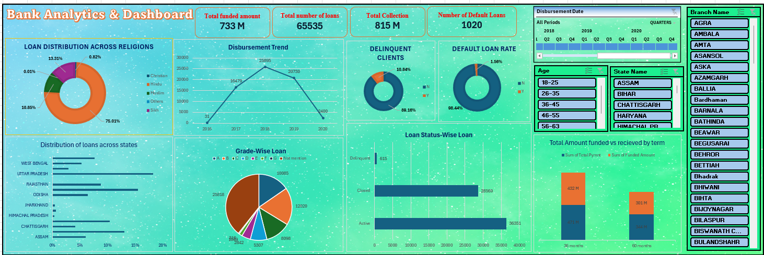
Excel Bank analytics Dashboard

Slide 5
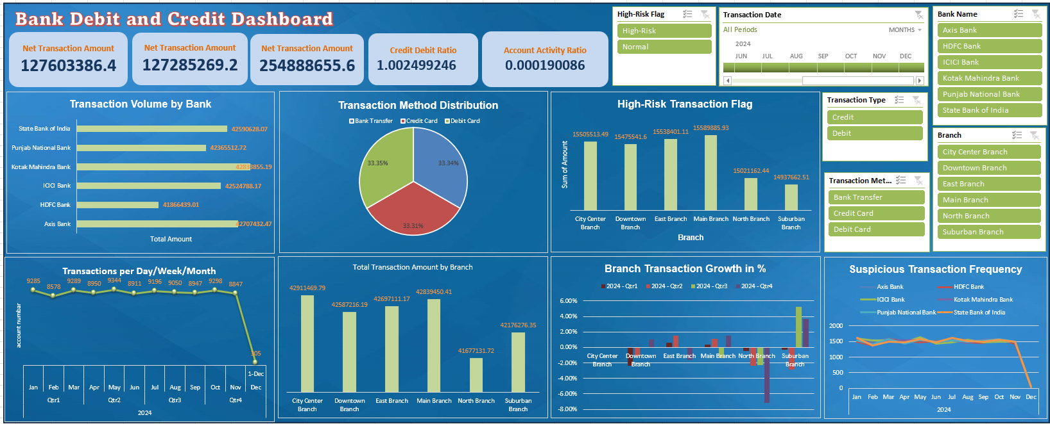
Excel Credit & Debit Dashboard

Slide 6
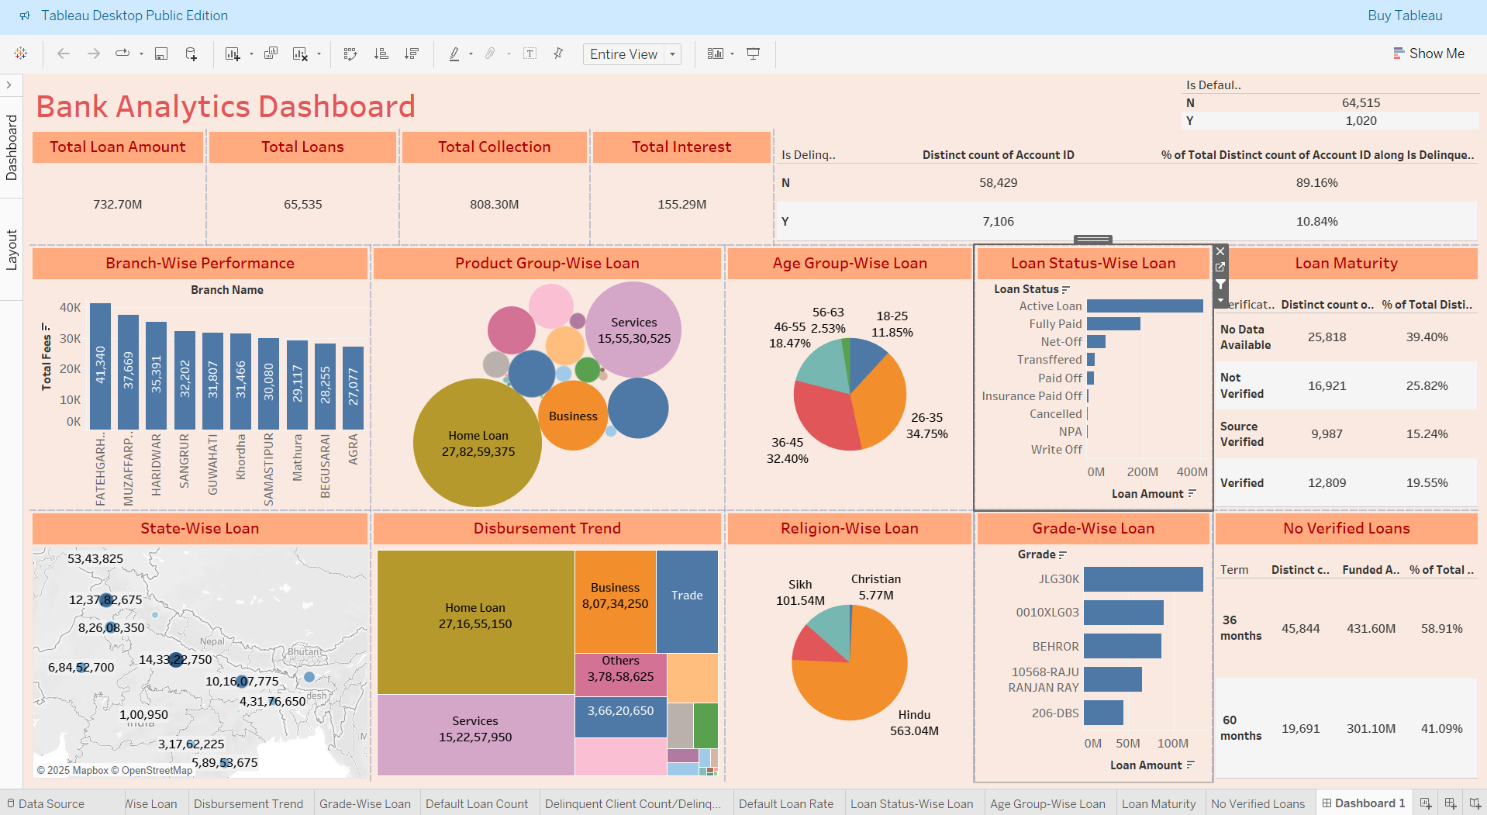
Tableau Bank analytics Dashboard

Slide 7
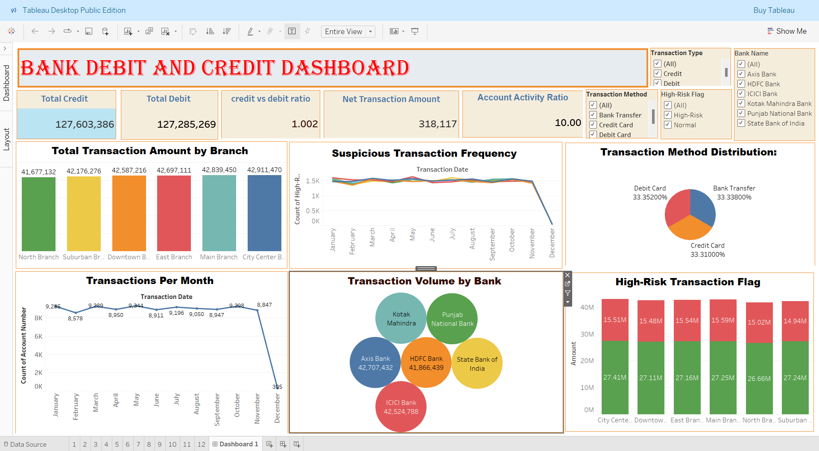
Tableau Credit & Debit Dashboard

Slide 8
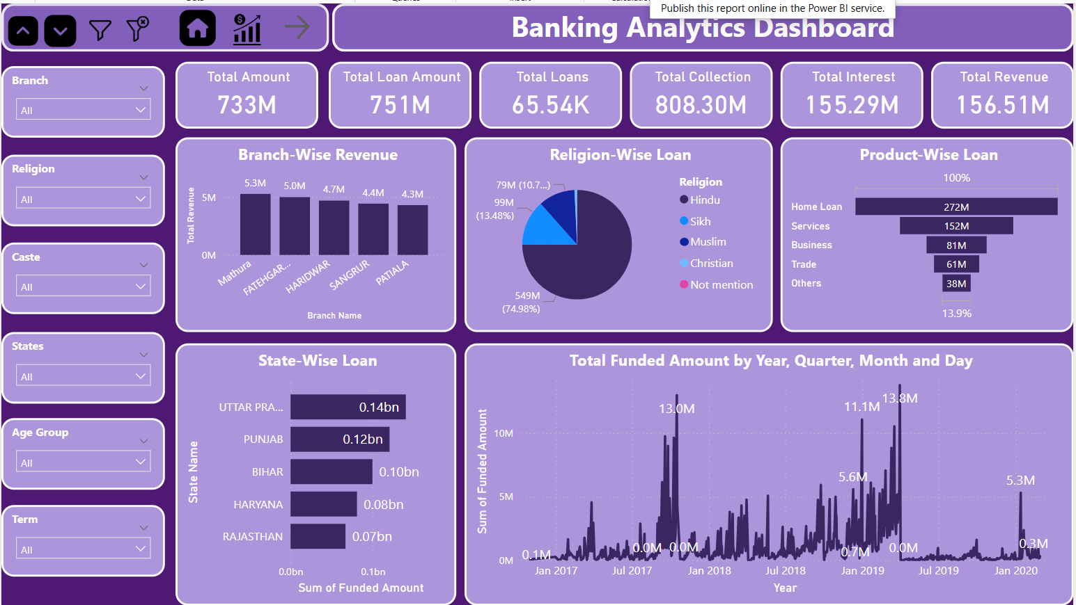
Power Bi Banking analytics Dashboard

Slide 9
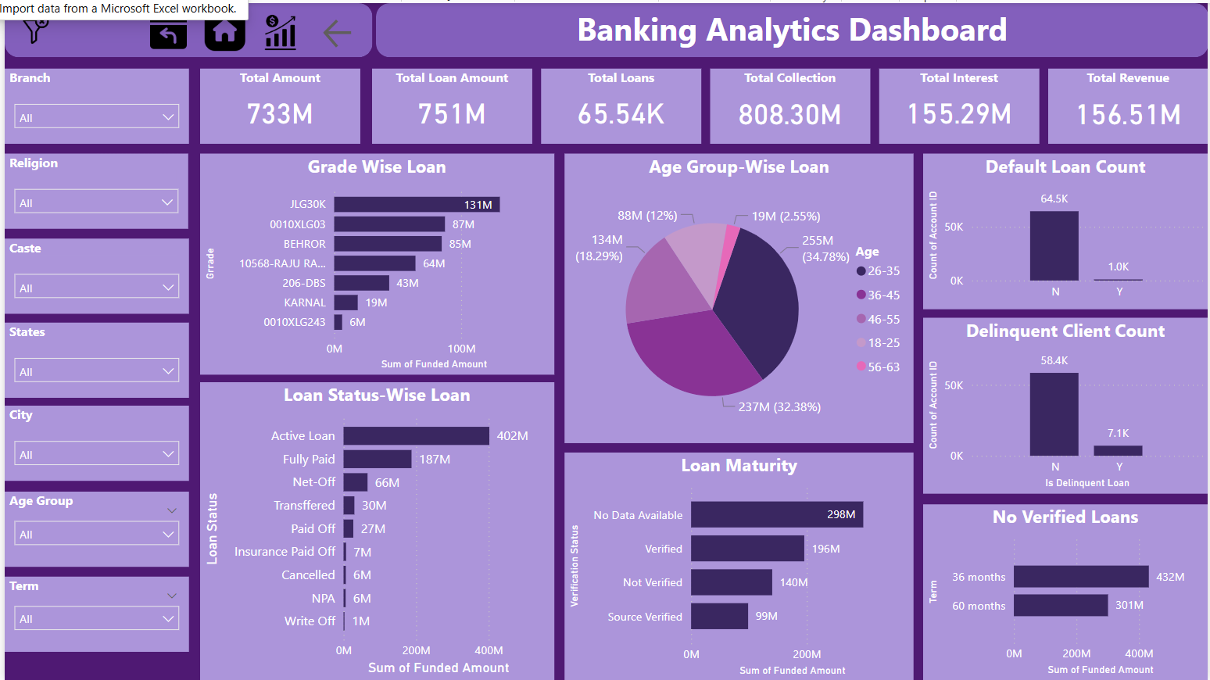
Power Bi Banking analytics Dashboard

Slide 10
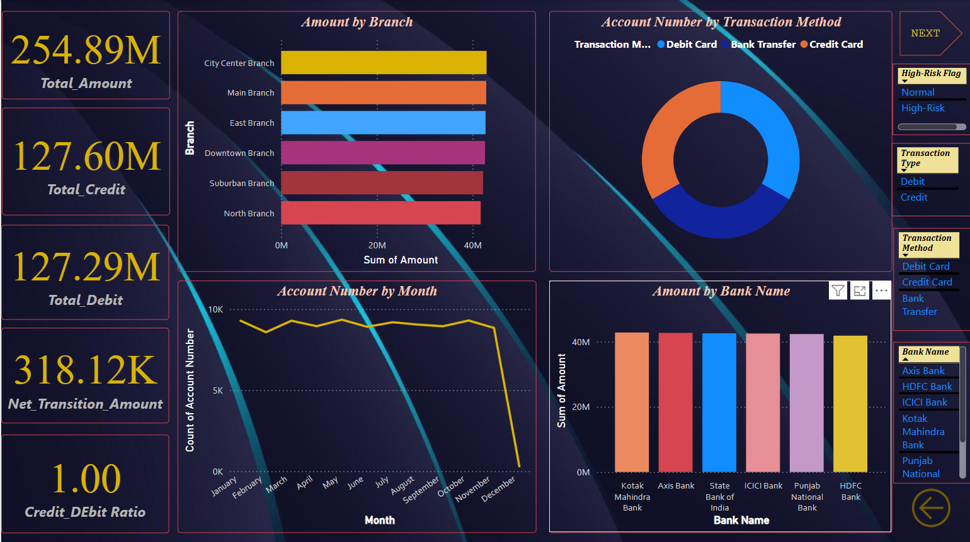
Power Bi Credit & Debit Dashboard

Slide 11
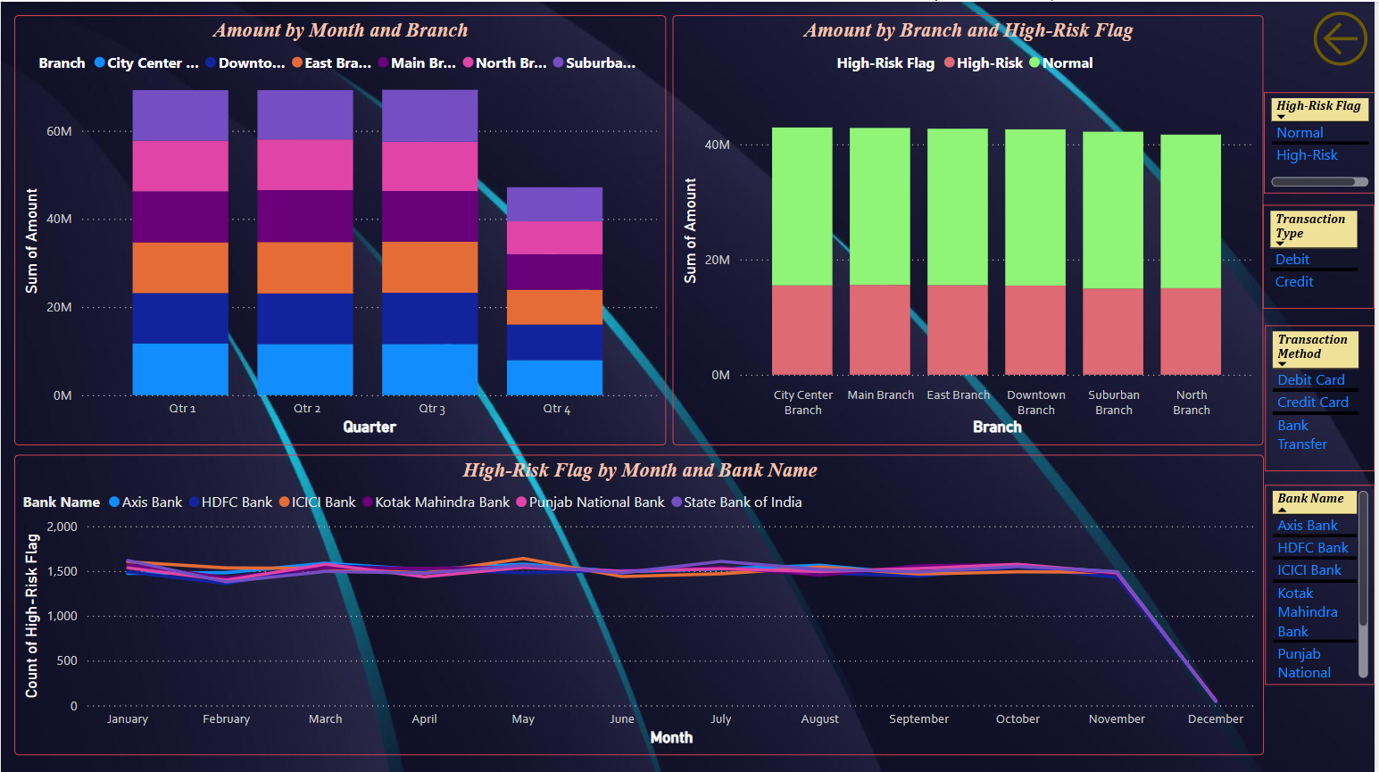
Power Bi Credit & Debit Dashboard

Slide 12
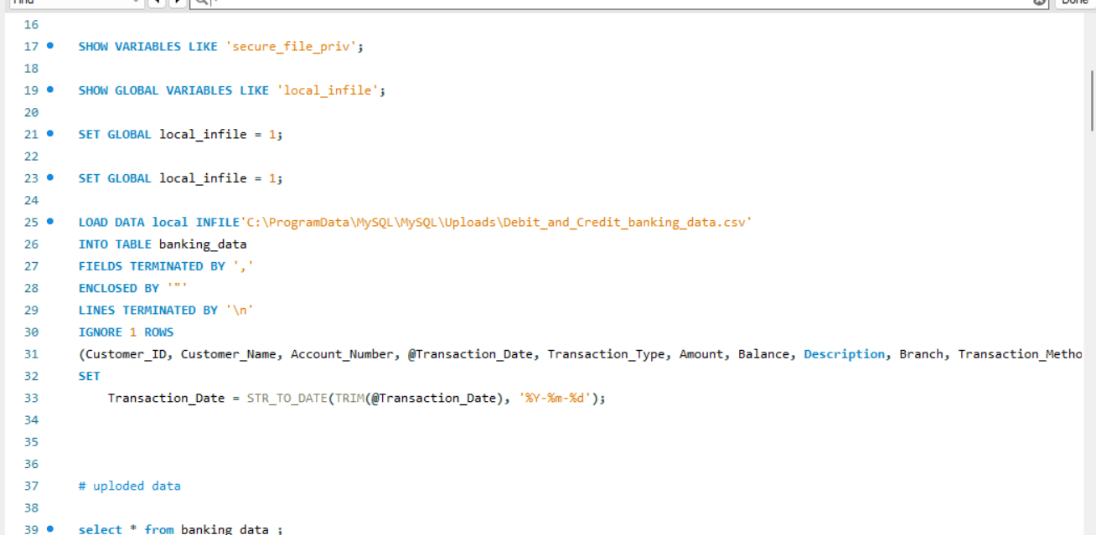
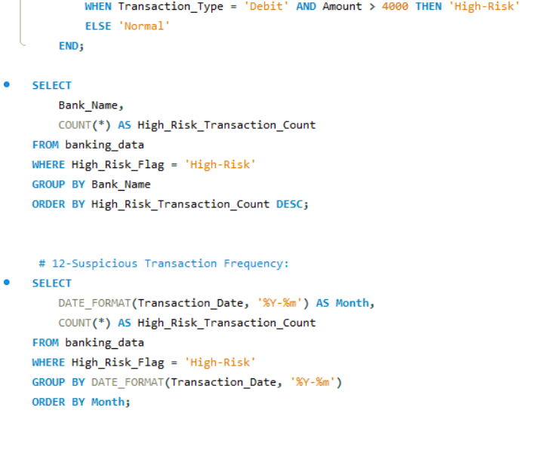
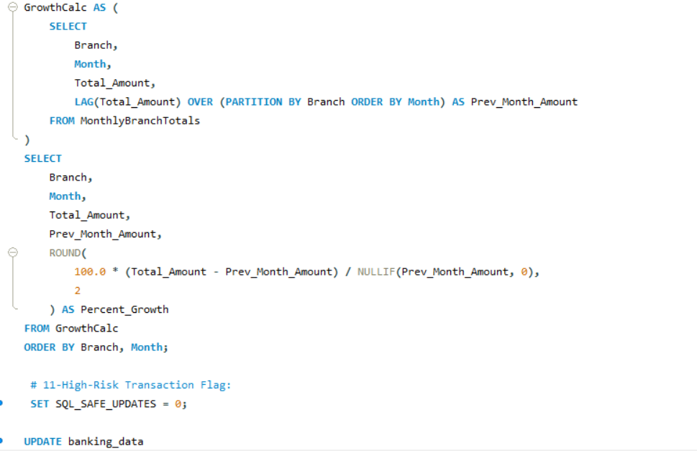
SQL Workbench for Banking data

Slide 13
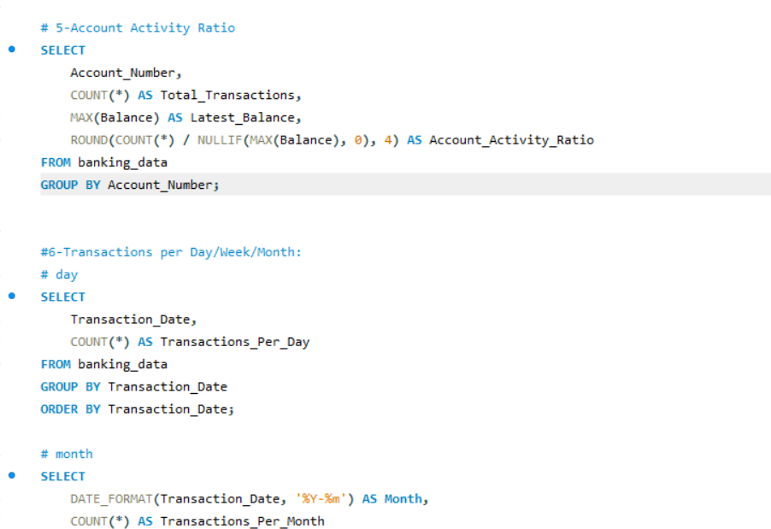
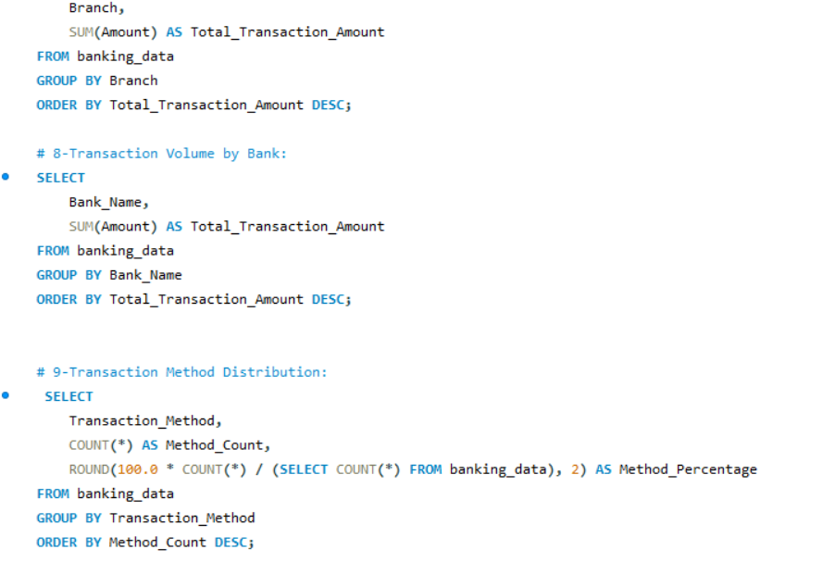
SQL Workbench for Banking data

Slide 14
Challenges faced during the project
Data Loading & Integration
Excel: Performance slowed down with large datasets. Filters were not operative for all the charts which was resolved later
Power BI: Required cleaning in Power Query;
Tableau: Joining large data sources sometimes caused memory issues; blending data across sheets was tricky.
SQL: Data loading was a difficult task, Complex joins to prepare a unified dataset; indexing and optimization were needed for performance.
Creating Calculated Fields Consistency Issues: Functions like IF, CASE, DATEDIFF behave differently in each tool.
DAX in Power BI: Required learning curve for measures like Credit to Debit Ratio, Delinquent Loan Rate.
Calculated Fields in Tableau: Syntactic differences and logic errors when using LOD (Level of Detail) expressions.
SQL: loading huge data, Building calculated columns required nesting queries or creating CTEs, which made debugging complex.
Data Cleaning and Preprocessing Null or inconsistent entries (especially in Transaction Type, Loan Status, Age, Religion)
Duplicate records from different bank sources
Visualization Challenges Tool Limitations: Not every tool supported the same types of visuals (e.g., radial charts, Maps, hierarchy trees).
Responsiveness: Dashboards in Excel became heavy; Tableau required performance optimization with extracts.
Dynamic Filters: Power BI and Tableau needed slicers and parameter controls to enable user-driven filtering.
Data Interpretation & Business Logic Alignment Mapping correct KPIs to business goals:
Credit to Debit Ratio
Delinquent Loan Rate
Suspicious Transaction Frequency
Ensuring visual insights matched domain understanding (e.g., identifying branches with high default rates or age groups with high risk)

Slide 15
THANK YOU

